Slide 1
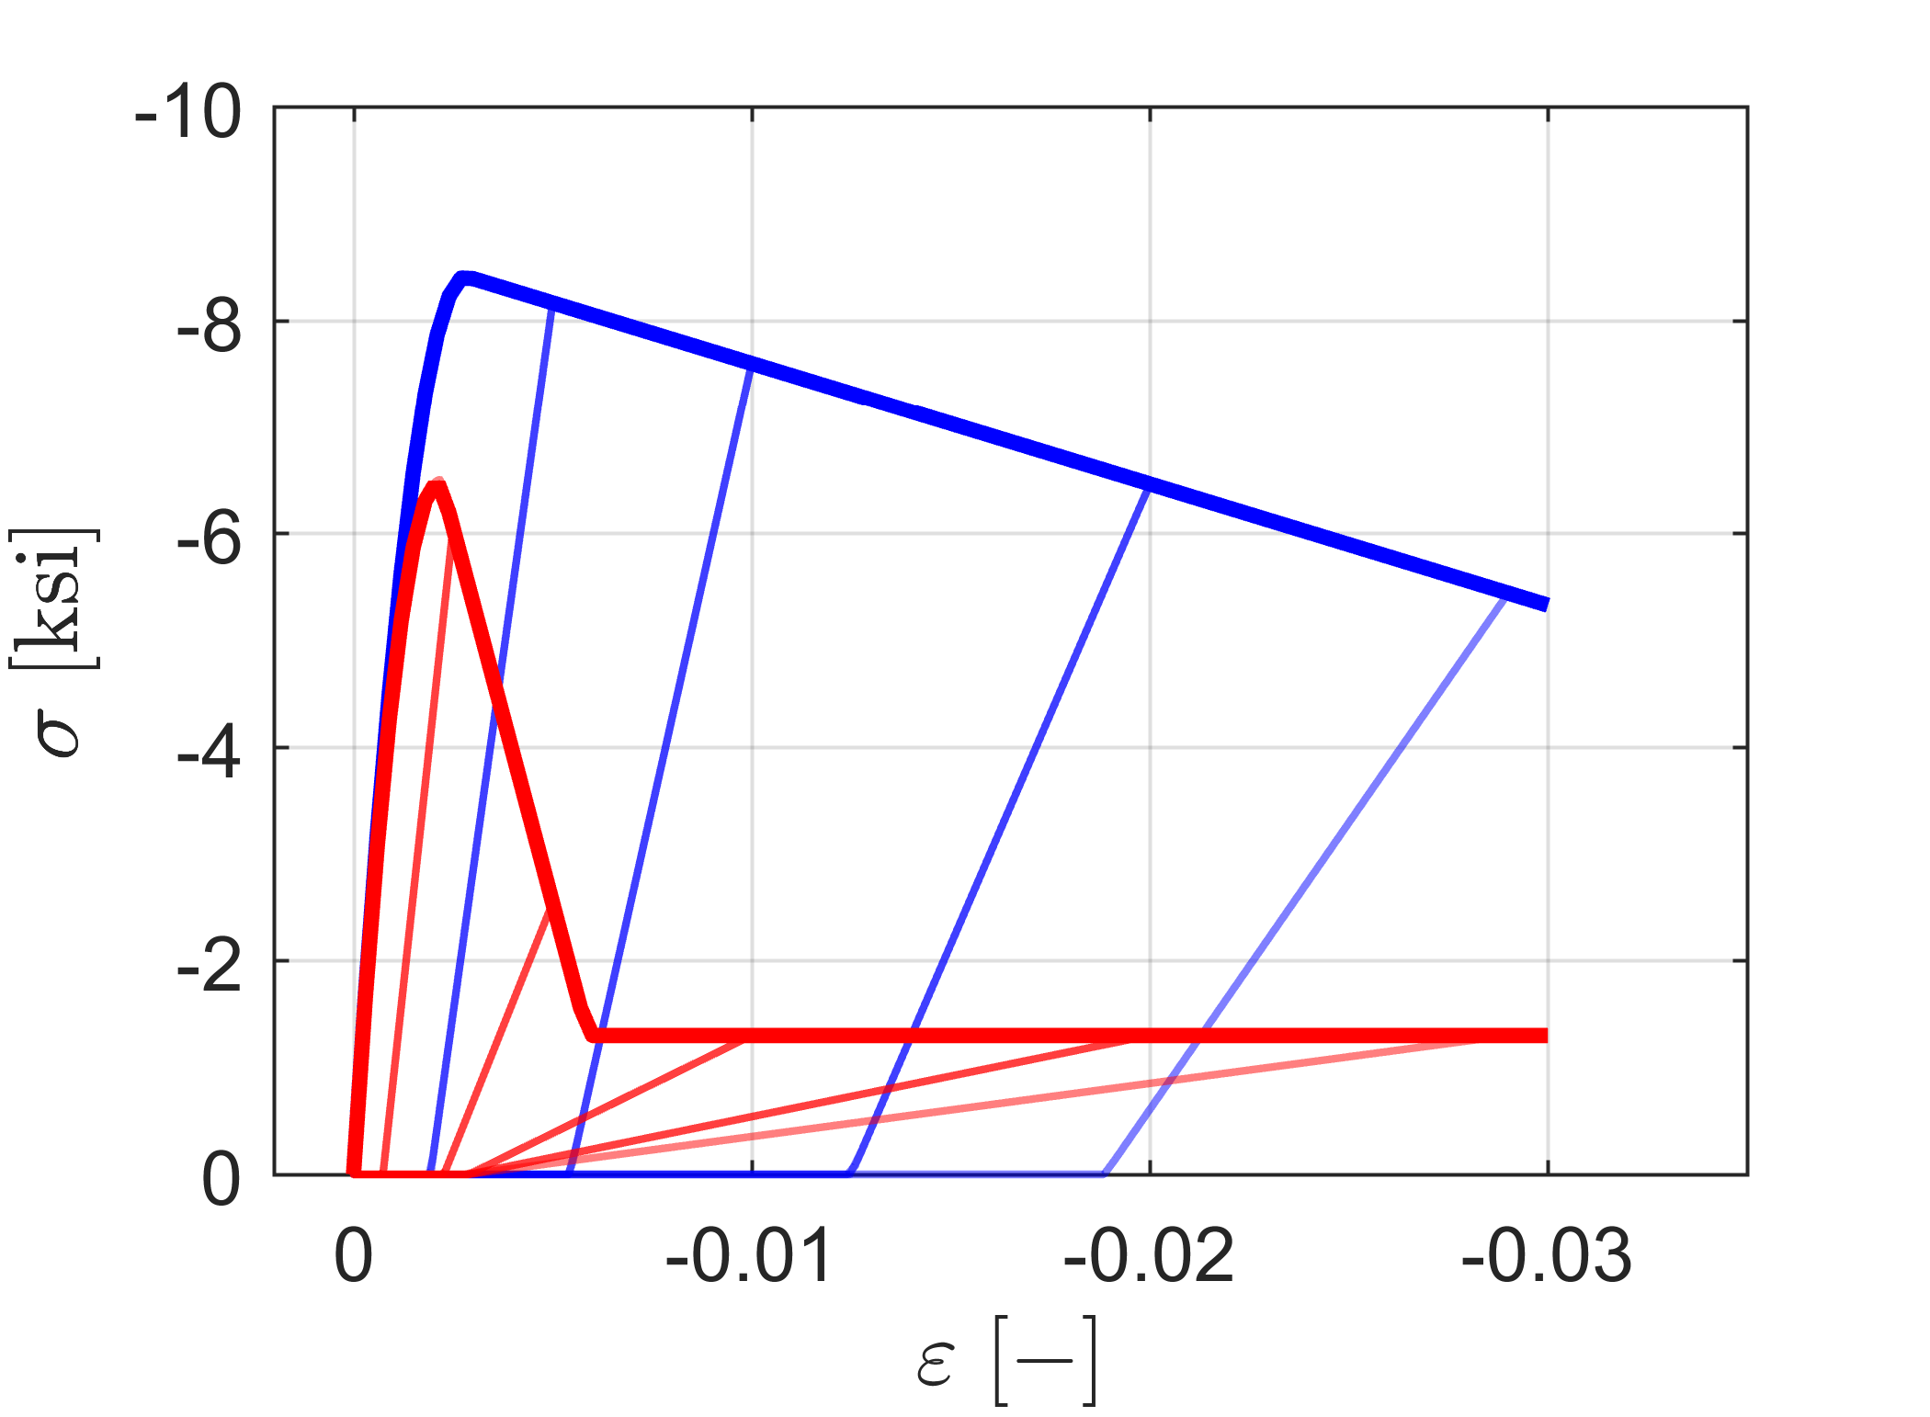
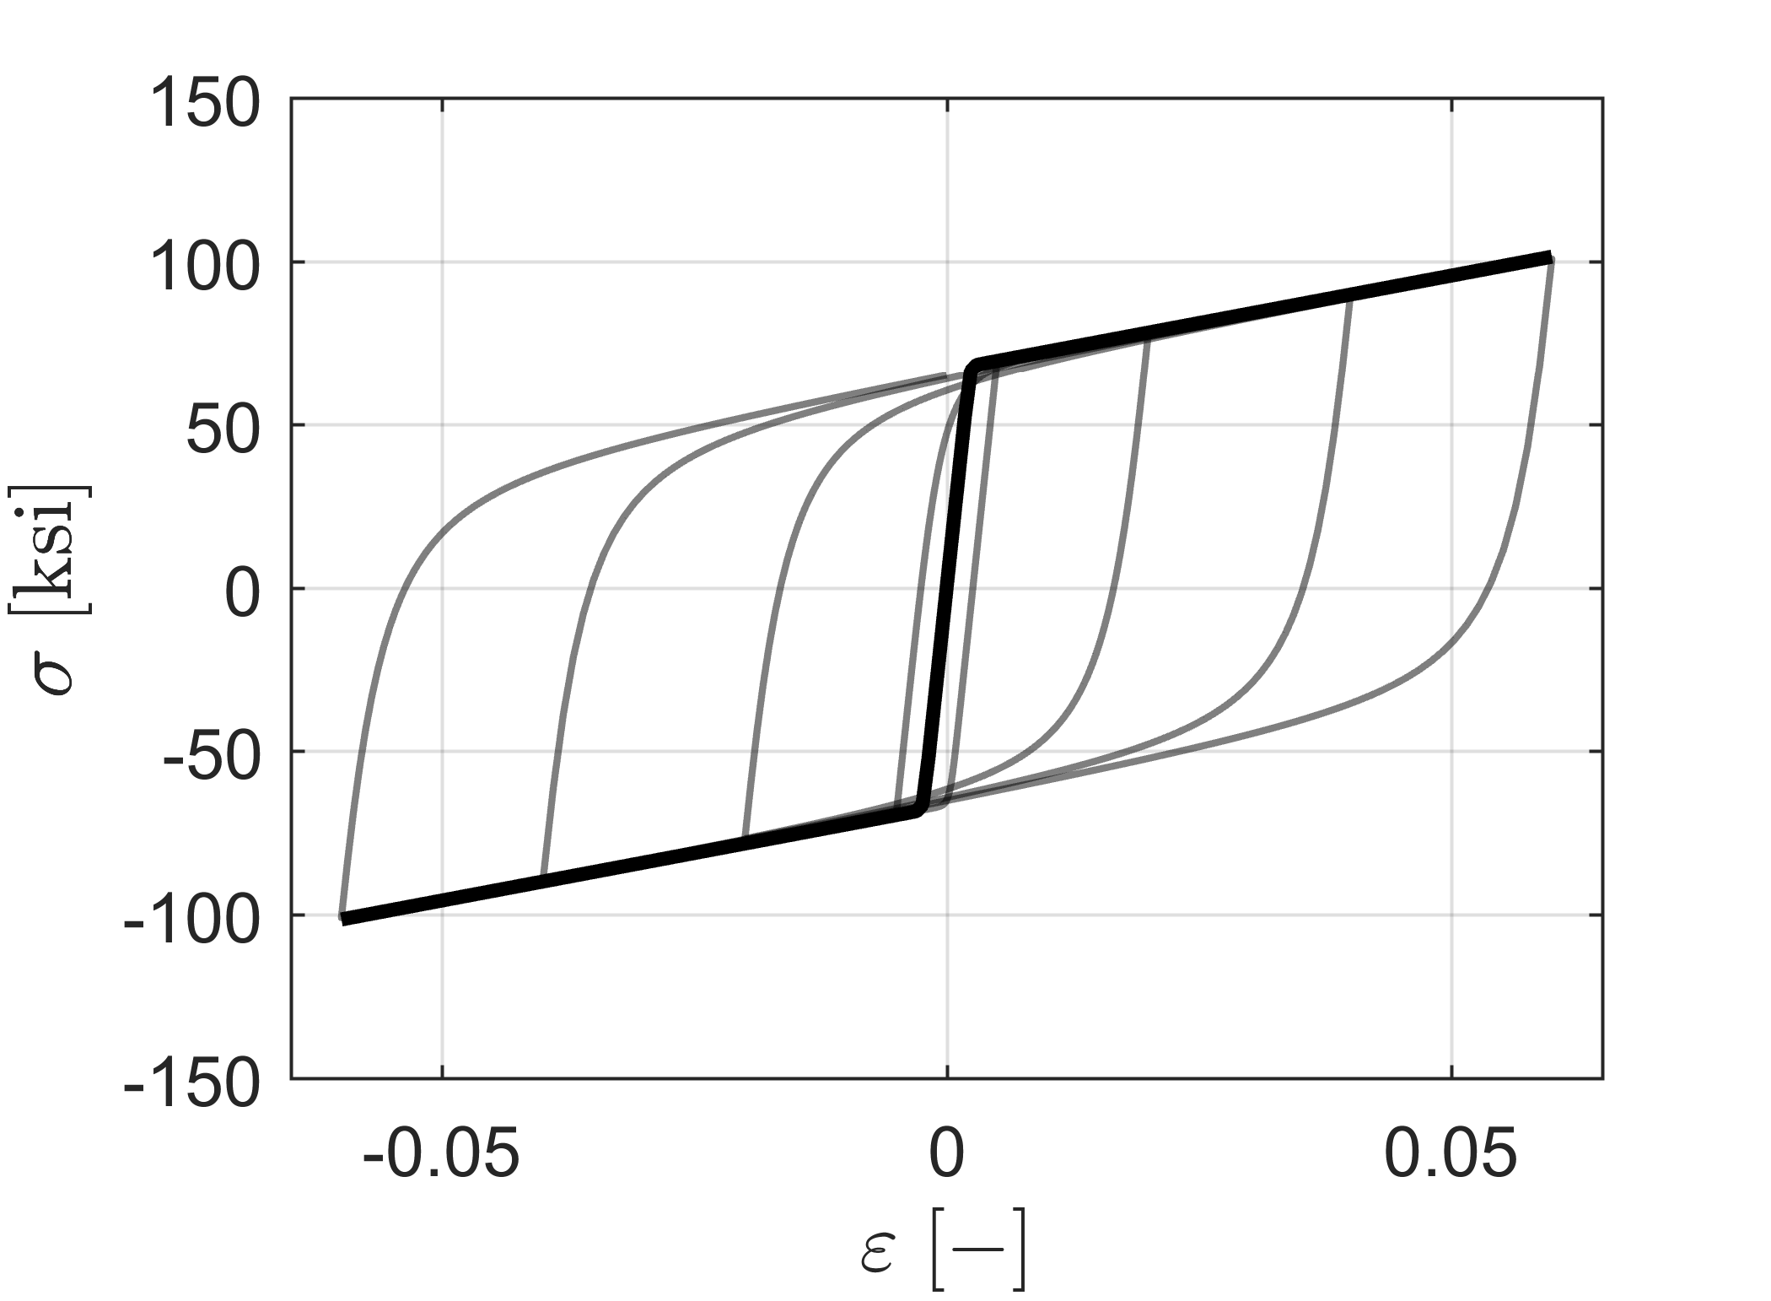
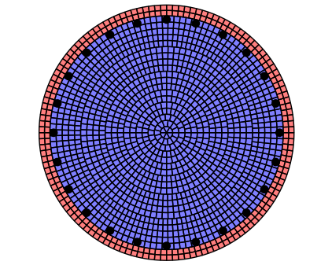

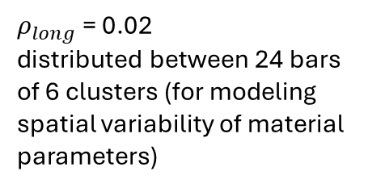
Lumped translational and rotational mass representing tributary length of bridge deck
$D_{col}$ = 5.5 ft
d = 2.5 ft
L = 19.7 ft
$ρ_{long}$ = 0.02
distributed between 24 bars of 6 clusters (for modeling spatial variability of material parameters)
Gauss Lobatto Integration Point

